Slide 1
HONEYPOT BASED CYBERSECURITY DECEPTION
Mamdouh , Mohammed , Majid

Slide 2

Content
01
02
03
04
Introduction
Comparative table of related works
Threat Model and Desirable Features
Technical Explanation
05
Methodology and rationale
06
Implementation
07
RESULT
08
Conclusion and Next Steps

Slide 3

INTRODUCTION
Problem: IoT devices with weak security are targeted by botnets like Mirai, leading to DDoS attacks and data theft.
Goal: Analyze IoT botnet activity using Cowrie honeypots, Suricata IDS and ELK Stack to identify attack patterns and enhance security.
Approach: Reproduce the paper's methodology to simulate botnet attacks and study IoT device vulnerabilities.

Slide 4
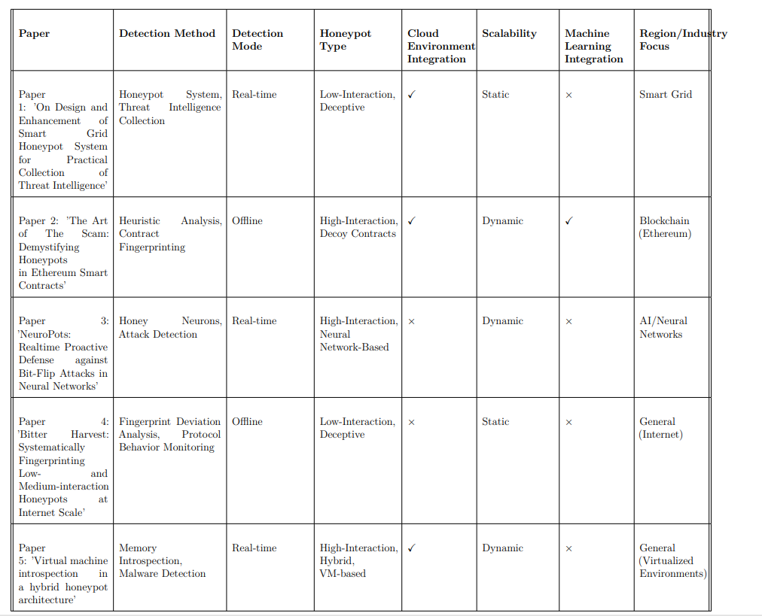
COMPARATIVE TABLE OF RELATED WORKS

Slide 5
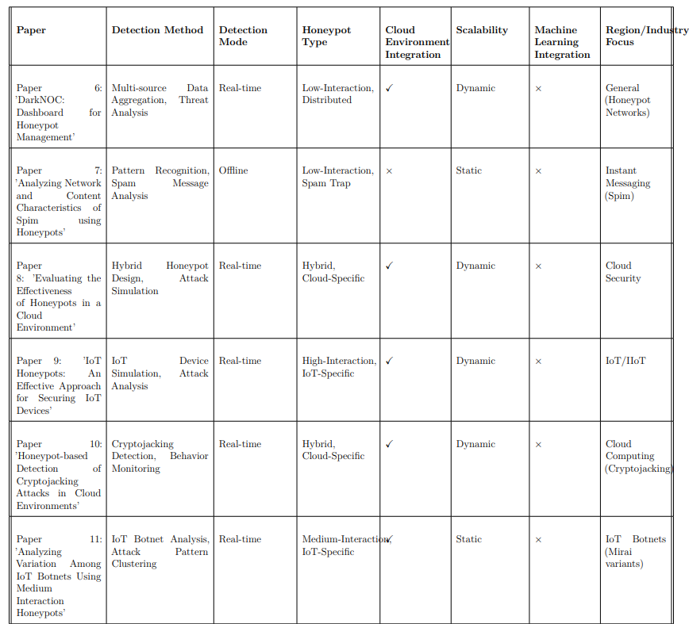
COMPARATIVE TABLE OF RELATED WORKS

Slide 6
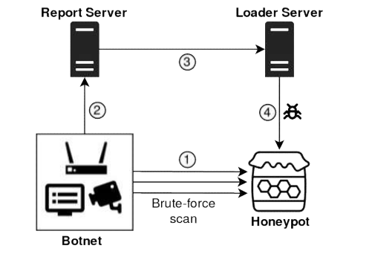
TECHNICAL EXPLANATION OF THE PROBLEM
Goal: Reproduce the paper's methodology for analyzing IoT botnet activities using Cowrie Honeypot and Mirai Botnet.
Setup:
Cowrie Honeypot: Simulates SSH/Telnet connections.
Suricata: Detect Malicious activities performed
Mirai Botnet: Simulates botnet attack on the honeypot.
ELK Stack: Used for log aggregation, storage, and visualization.

Slide 7
CHALLENGES FACED
1
2
System Resource Constraints
Dependency Issues
High data volume from botnet interactions required optimizing memory usage.
Conflicting Versions of libraries

Slide 8
EXPERIMENTAL SETUP
Software: Ubuntu-based system, Cowrie, Suricata, Apache, Levenshtein Distance, Postfix, Elasticsearch, Kibana, Filebeat.
Hardware: Minimum 2 CPU cores, 4GB RAM, 40GB disk space for log storage.
Steps:
Install Cowrie and configure as SSH server.
Deploy Mirai Botnet to simulate attacks.
Use Filebeat to ship logs to Elasticsearch and visualize in Kibana.

Slide 9
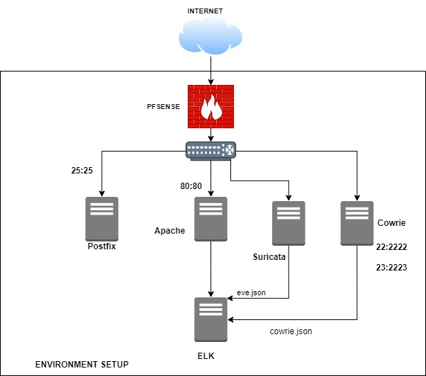
Environment Setup

Slide 10
THREAT MODEL AND DESIRABLE FEATURES
Threat Model:
Malicious IoT botnets using weak credentials to exploit SSH/Telnet services.
Attackers targeting vulnerable IoT devices for large-scale DDoS attacks.
Desirable Features:
Real-time attack detection.
Low false-positive rate.
Efficient resource usage for large-scale deployments.

Slide 11
METHODOLOGY AND RATIONALE
Why this Methodology?
Cowrie provides realistic attack scenarios and captures valuable attack data.
Suricata logs all malicious activities performed in real time
The ELK Stack offers powerful log analysis tools to visualize and understand attack patterns.
Success Metrics:
Detection accuracy of botnet activity.
Log visualization effectiveness.
Resource consumption and optimization.

Slide 12
IMPLEMENTATION DETAILS
What was Implemented:
Set up a Cowrie Honeypot, Suricata, Mirai Botnet, and ELK Stack.
Captured and analyzed botnet attack data.
How it was done:
Configured Cowrie to mimic SSH/Telnet services.
Configured Suricata to Detect malicious traffic
Launched Mirai Botnet to simulate real-world IoT attacks.
Analyzed logs in ELK Stack to identify attack patterns.
Where it was done:
Ubuntu VMs: Used isolated virtual environments for safe botnet simulation and honeypot deployment.
ELK Stack and Filebeat installed locally on the VM for real-time log analysis.

Slide 13
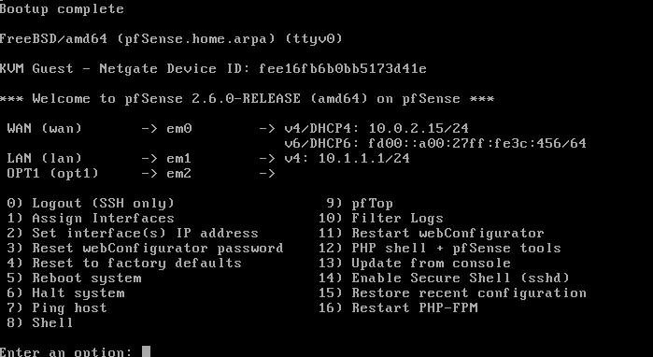

RESULTS – Pfsense Setup

Slide 14
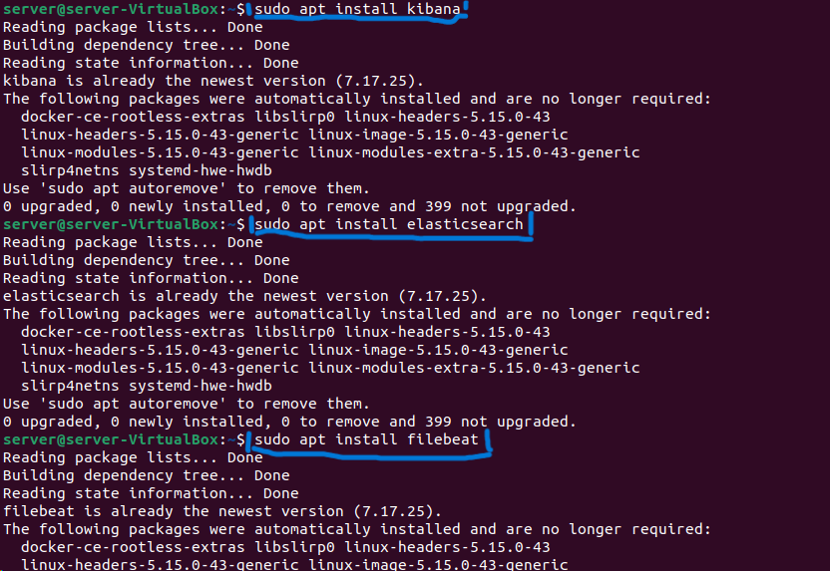
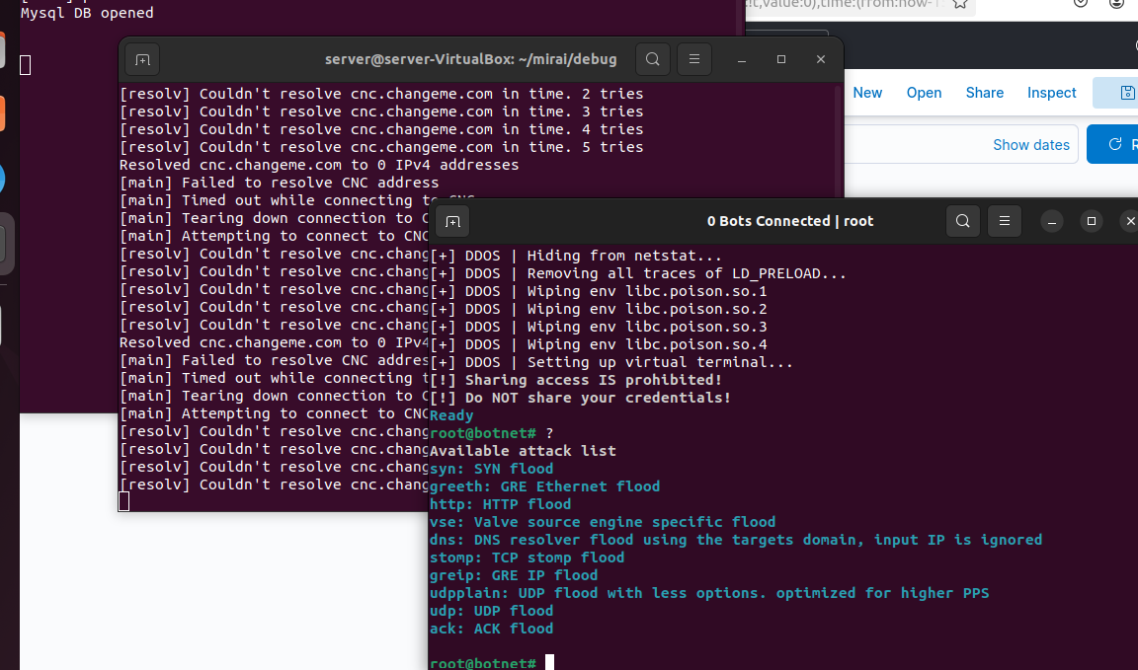
RESULTS – ELK, MIRAI Installation

Slide 15
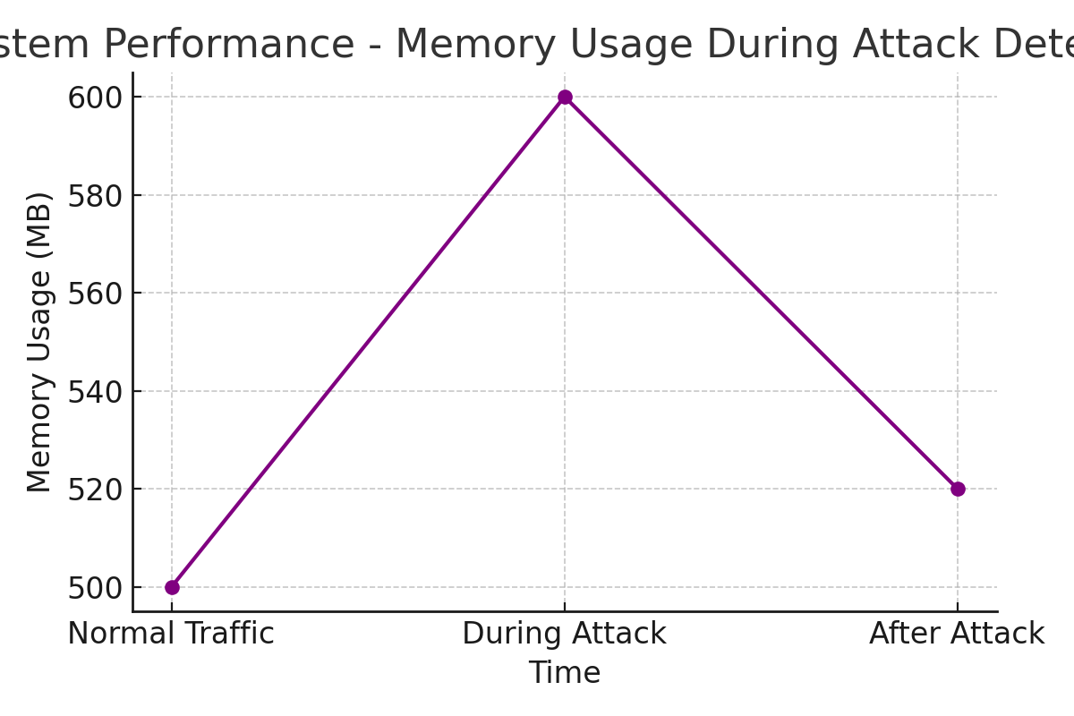
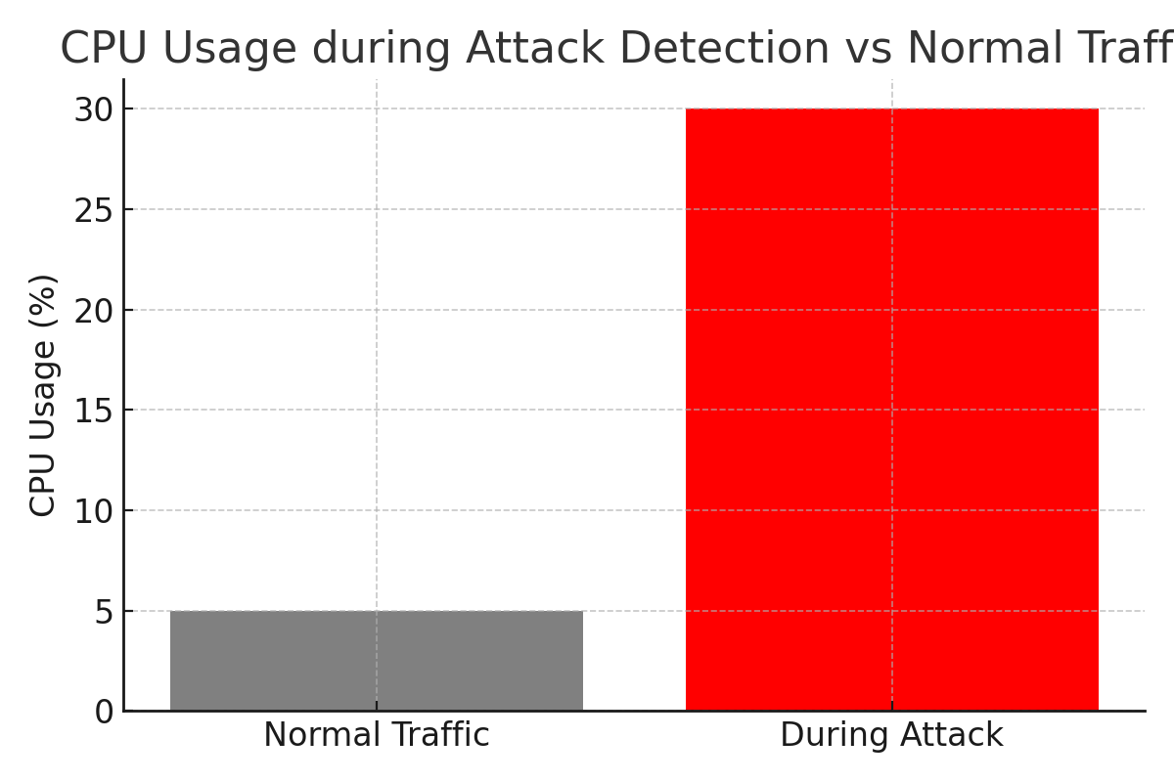
RESULTS – ELK Installation

Slide 16
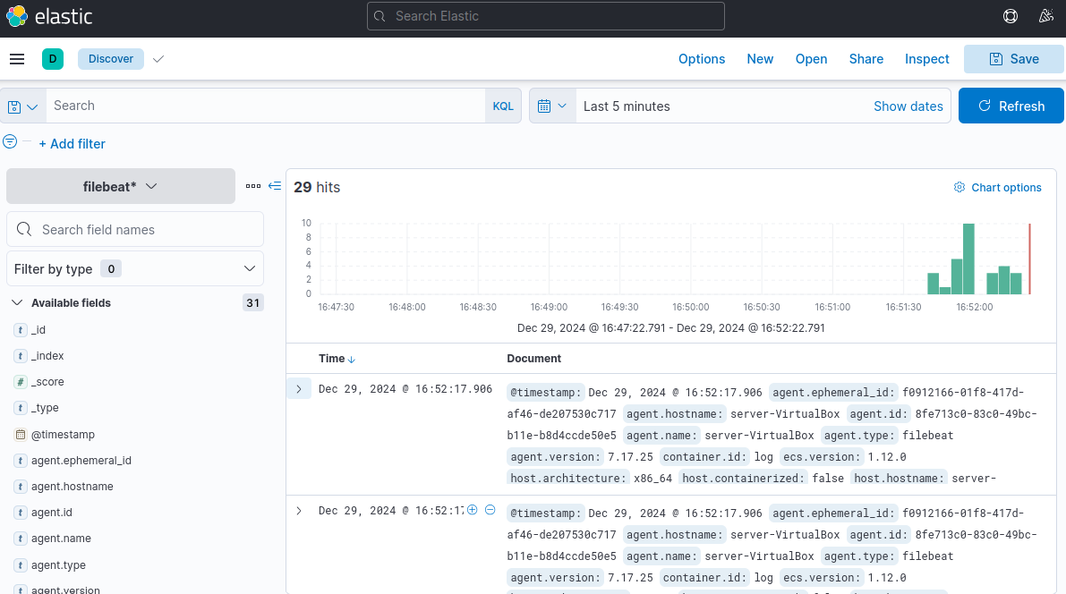
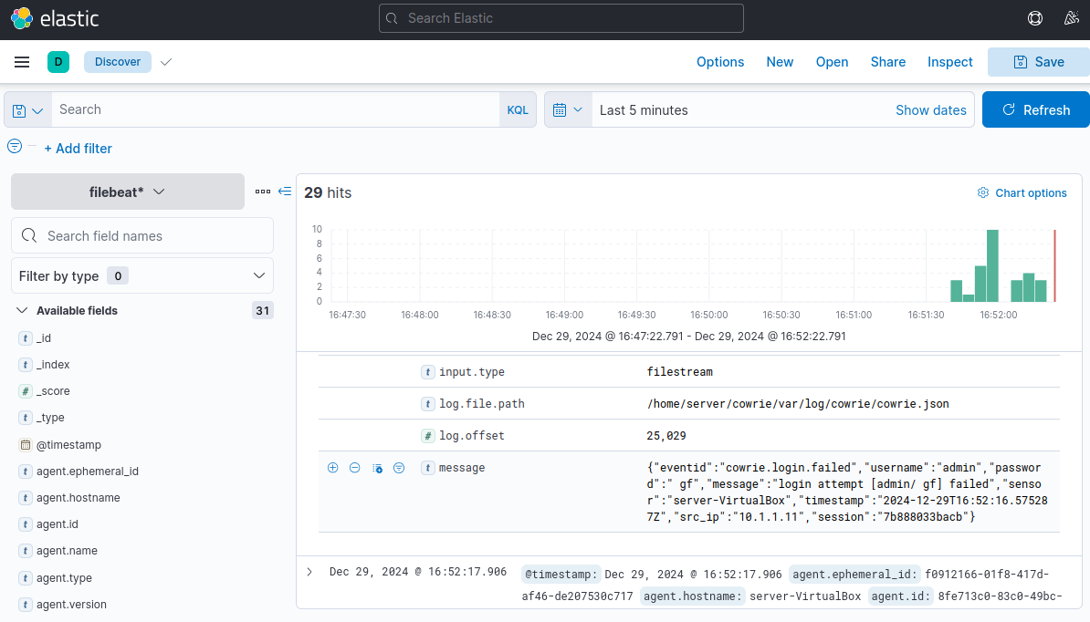
RESULTS – KIBANA ALERTS

Slide 17
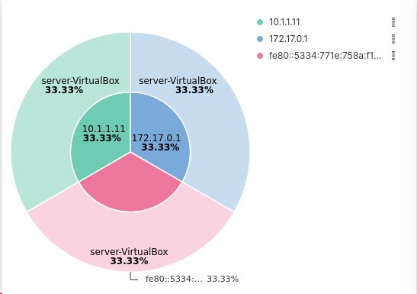
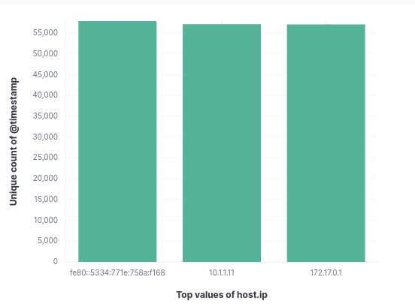
RESULTS – KIBANA ALERTS

Slide 18
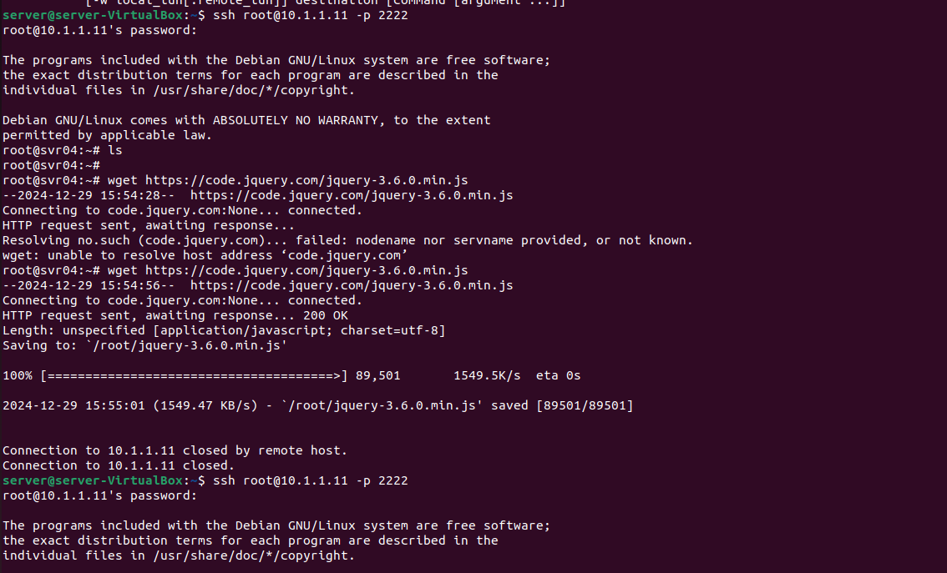
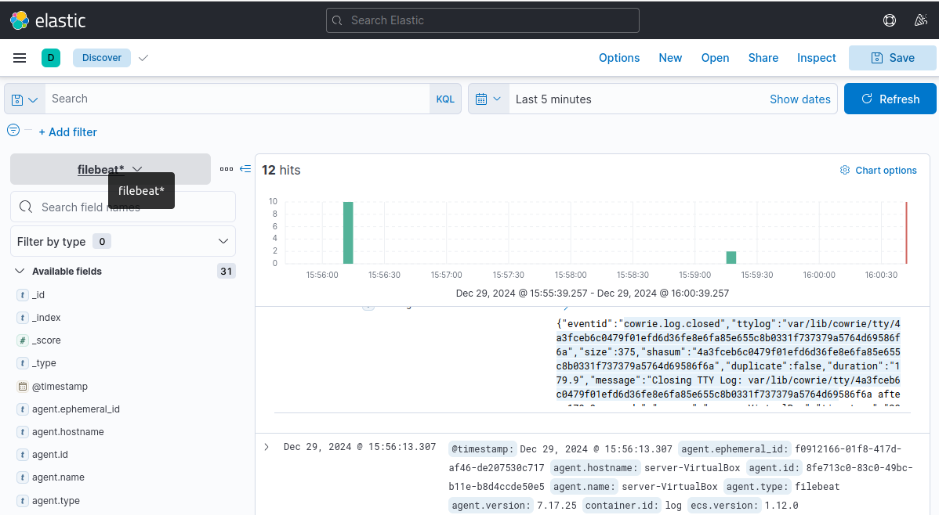
RESULTS – KIBANA ALERTS (Detecting Downloaded Files)

Slide 19
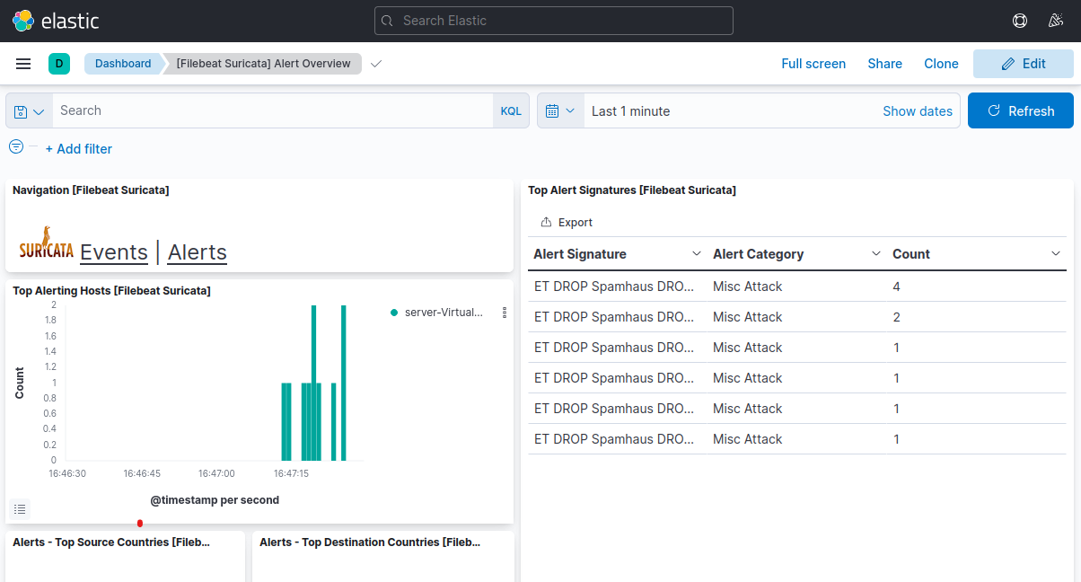
RESULTS – SURICATA ALERTS

Slide 20
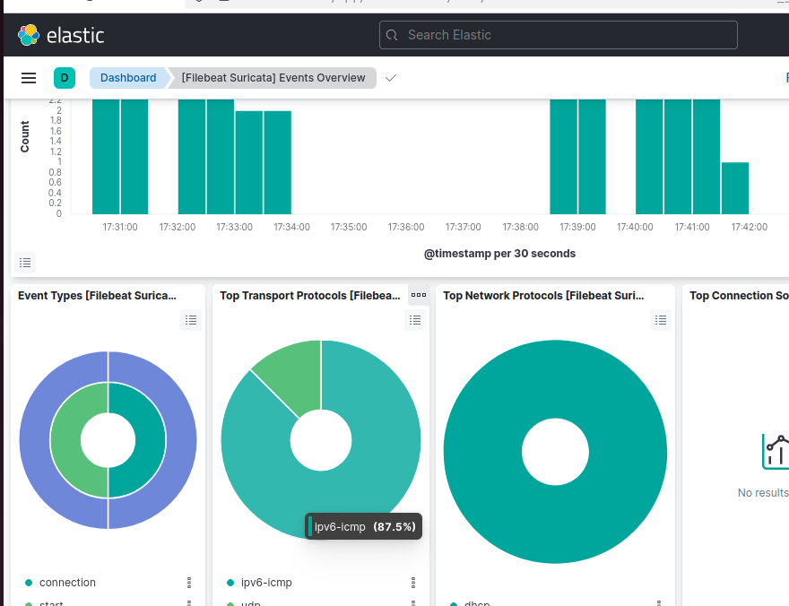
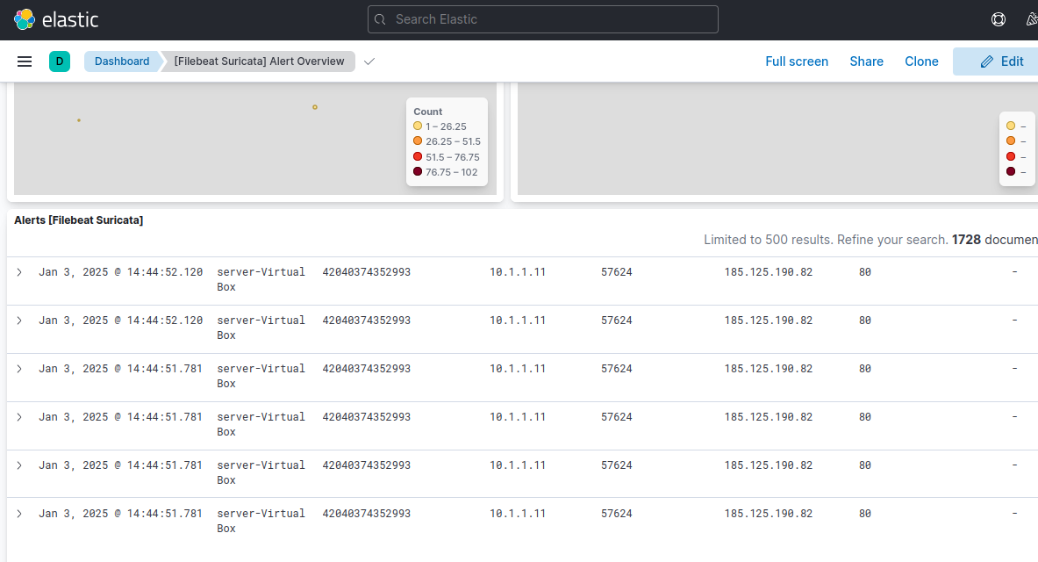
RESULTS – SURICATA ALERTS

Slide 21
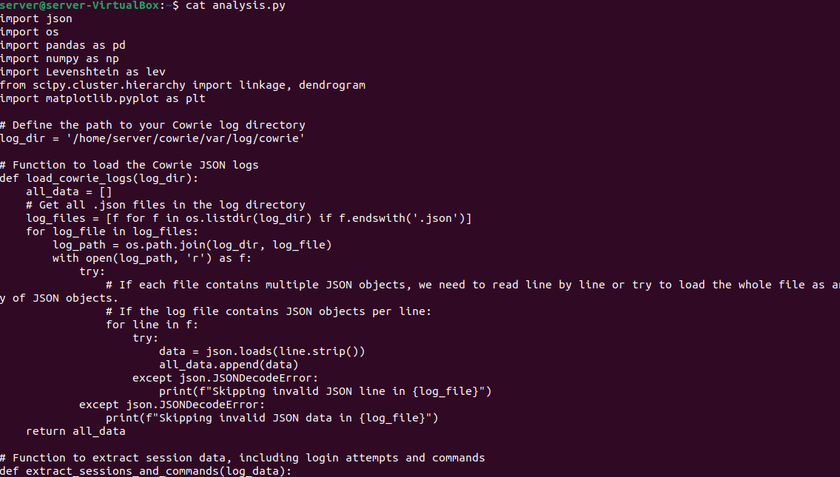
RESULTS – Anomaly (Levensthein Distance)
Levenshtein Distance is a string-based metric that calculates the minimum number of single-character edits required to transform one string into another. It helps detect variations in attacker commands to identify altered attack techniques.
This code processes Cowrie honeypot logs, detects command anomalies, clusters session data for analysis, and visualizes relationships with a dendrogram. Results are saved for deeper investigation.

Slide 22
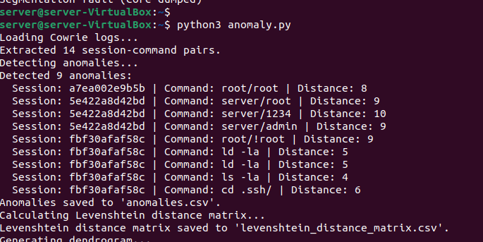
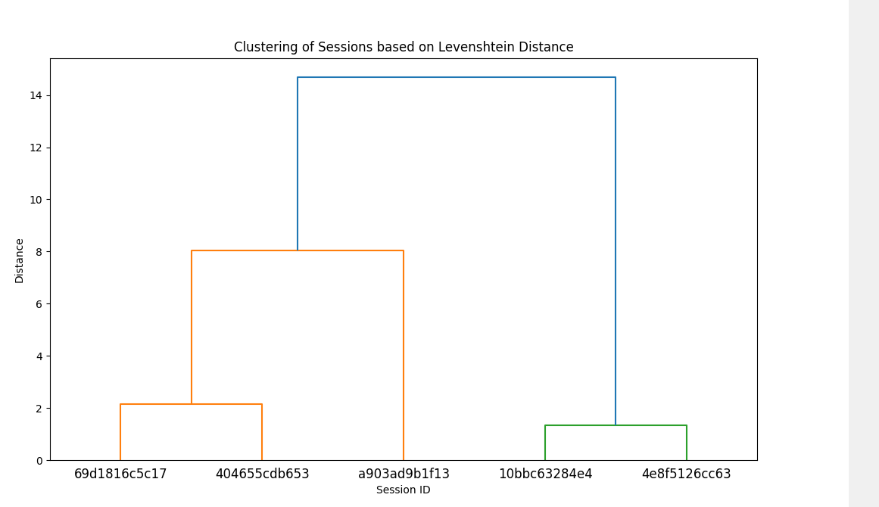
RESULTS – Anomaly (Levensthein Distance)

Slide 23
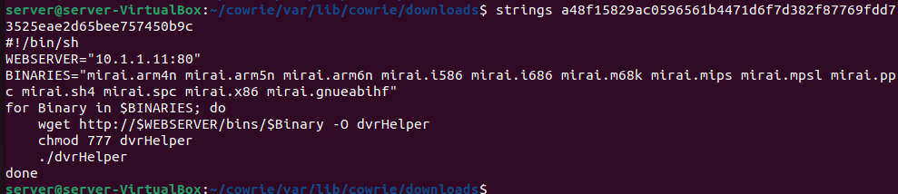
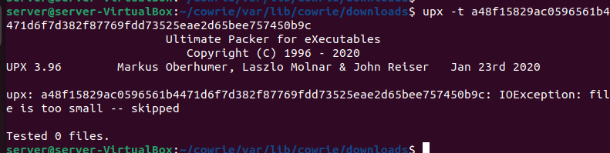
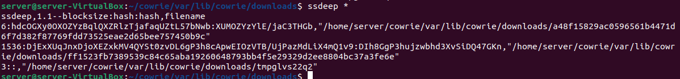
RESULTS – FILE ANALYSIS OF DOWNLOADED FILES

Slide 24
CONCLUSION
This project successfully reproduced the methodology for detecting IoT botnet attacks using Cowrie Honeypot, Mirai Botnet, the ELK Stack, and Suricata. The experiment captured meaningful insights into botnet attack patterns, including common brute-force attempts and frequently targeted credentials. Suricata further enhanced the detection capabilities by providing network-level analysis. These results validate the effectiveness of our setup for understanding IoT security challenges.

Slide 25
THANK YOU

